Slide 1
Mastering NT Greek
21. Perfect Participles
By Ted Hildebrandt © 2003
Baker Academic

Slide 2
Rapping the Lord’s Prayer
Πάτερ ἡμῶν ὁ ἐν τοῖς οὐρανοῖς father our the one in heaven
ἁγιασθήτω τὸ ὄνομά σου make holy name your
ἐλθέτω ἡ βασιλεία σου let come kingdom your
γενηθήτω τὸ θέλημά σου, let be will your

Slide 3
Rapping the Lord’s Prayer
ὡς ἐν οὐρανῷ καὶ ἐπὶ γῆς· as in heaven also on earth
τὸν ἄρτον ἥμῶν τὸν the bread our
ἐπιούσιον δὸς ἡμῖν σήμερον· daily give us today

Slide 4
Rapping the Lord’s Prayer
καὶ ἄφες ἡμῖν τὰ ὀφειλήματα ἡμῶν and forgive us trespasses our
ὡς καὶ ἡμεῖς ἀφήκαμεν as also we have forgiven
τοῖς ὀφειλέταις ἡμῶν the ones trespassing us

Slide 5
Rapping the Lord’s Prayer
καὶ μὴ εἰσενέγκῃς ἡμᾶς and do not lead us εἰς πειρασμόν into temptation ἀλλὰ ῥῦσαι ἡμᾶς ἀπὸ but deliver us from τοῦ πονηροῦ the evil one

Slide 6
2-1-2 Paradigms - Chant this
2 1 2
λόγος γραφή ἱερόν
λόγου γραφῆς ἱεροῦ
λόγῳ γραφῇ ἱερῷ
λόγον γραφήν ἱερόν
λόγοι γραφαί ἱερά
λόγων γραφῶν ἱερῶν
λόγοις γραφαῖς ἱεροῖς
λόγους γραφάς ἱερά

Slide 7
3rd Declension Chantables
χαρίς ὄνομα, πίστις
χάρις ὄνομα πίστις
χάριτος ὀνόματος πίστεως
χάριτι ὀνόματι πίστει
χάριτα ὄνομα πίστιν
χάριτες ὀνόματα πίστεις
χαρίτων ὀνομάτων πίστεων
χάρισι(ν) ὀνόμασι(ν) πίστεσι(ν)
χάριτας ὀνόματα πίστεις

Slide 8
PAI Verb Chant
λύω λύομεν
λύεις λύετε
λύει λύουσι(ν)

Slide 9
The "is" verb PAI -- εἰμί
εἰμί ἐσμέν εἶ ἐστέ ἐστί(ν) εἰσί(ν)

Slide 10
Imperfect εἰμί
ἤμην ἦμεν ἦς ἦτε ἦν ἦσαν

Slide 11
Person Personal Pronoun Chant
Singular Plural
Nom. ἐγώ σύ ἡμεῖς
Gen. μου σου ἡμῶν Dat. μοι σοι ἡμῖν Acc. με σε ἡμάς
αὐτός, αὐτη, αὐτό (he, she, it)

Slide 12
Present Middle/Passive Indicative
λύομαι, -ομεθα -ῃ, -εσθε -εται, -ονται
I am loosed/am being loosed
I loose myself/am loosing [for myself]

Slide 13
Shape of the Future in Greek
λύσω λύσομεν I will loose We will loose
λύσεις λύσετε You will loose You all will loose
λύσει λύσουσι(ν) S/he/it will loose They will loose
Chant this one

Slide 14
Future Middle Paradigm
λύσομαι -όμεθα -ῃ -εσθε -εται -ονται
I will loose (for myself) We will loose (for ourselves) …

Slide 15
Demonstrative and Relative Pronouns Summary
ἐκεῖνος, ἐκείνη, ἐκεῖνο = that
οὗτος, αὕτη, τοῦτο τούτου, ταύτης, τούτου = this
ὅς ἥ ὅ = Relative (who, which) οὗ ἧς οὗ

Slide 16
Imperfect Active Paradigm of λύω
Chant: ἐλυον, ν, ς, ε, μεν, τε, ν I was loosing, …

Slide 17
Imperfect Middle/Passive (IM/PI)
Chant: ἐλυόμην ου, ετο, ομεθα, εσθε, οντο
I was being loosed

Slide 18
Second Aorist Active Chant
ἔλαβον ν, σ, ε, μεν, τε, ν

Slide 19
Second Aorist Middle Chant
ἐγενόμην -ου, -ετο, -ομεθα, -εσθε, -οντο

Slide 20
Aorist Stem Changes -- 8 to know
ἔρχομαι == ἦλθον (I came, went)
βλέπω == εἶδον (I saw)
λέγω == εἶπον (I said)
γίνομαι == ἐγενόμην (I became)
γινώσκω == ἔγνων (I knew)
ἔχω == ἔσχον ( I had)
λαμβάνω == ἔλαβον (I took)
εὑρίσκω == εὗρον (I found)

Slide 21
1st Aorist Active Paradigm
Learn: ἔλυσα: I loosed… --, ς, ε, μεν, τε, ν

Slide 22
1st Aorist Middle Paradigm
Learn: ἐλυσάμην: I loosed for myself -ω, -ατο, -αμεθα, -ασθε, -αντο

Slide 23
Chanting the PA and PM/P Participle
Present Active: ptc = participle
Nom. λύων λύουσα λῦον Gen. λύοντος λύουσης λύοντος
Present Middle/Passive
Nom. λυόμενος λυομένη λυόμενον Gen. λυομένου λυομένης λυομένου

Slide 24
Forms to Chant to
First Aorist Active 3-1-3 (chant)
Nom. λύσας λύσασα λύσαν Gen. λύσαντος λυσάσης λύσαντος
Nom. λυθείς λυθεῖσα λυθέν Gen. λυθέντος λυθείσης λυθέντος
First Aorist Middle 2-1-2 (non-chant)
Nom. λυσάμενος λυσαμένη λυσάμενον Gen. λυσαμένου λυσαμένης λυσαμένου

Slide 25
Perfect Participles
Translations
Adverbial = “after having driven”
Adjectival Attributive = “the girl having spoken”
Substantive = “the one who has run”

Slide 26
Perfect Active Participle formation
Active Masc/Neut + ot
Redup Stem Perf k Ptc 3/3 endings λε + λυ + κ + οτ + ος
Active Fem + ui
Redup Stem Perf k Ptc 1 endings λε + λυ + κ + υι + α

Slide 27
Perfect Active Ptc Paradigm
Perfect Active Participles
Singular Masc 3 Fem 1 Neuter 3
Nom. λελυκώς λελυκυῖα λελυκός Gen. λελυκότος λελυκυίας λελυκότος Dat. λελυκότι λελυκυίᾳ λελυκότι Acc. λελυκότα λελυκυῖαν λελυκός
In the Neut. Nom/Acc. κοτς → κος

Slide 28
Perfect Active Ptc Paradigm
Perfect Active Participles
Plural Masc 3 Fem 1 Neuter 3
Nom. λελυκότες λελυκυῖαι λελυκότα Gen. λελυκότων λελυκυιῶν λελυκότων Dat. λελυκόσι(ν) λελυκυίαις λελυκόσι(ν) Acc. λελυκότας λελυκυῖας λελυκότα

Slide 29
Perfect Mid/Passive Participle formation
Middle/Passive
Redup Stem Ptc 2-1-2 endings
λε + λυ + μεν + ος λε + λυ + μεν + η λε + λυ + μεν + ον

Slide 30
Perfect Mid/Passive Ptc Paradigm
Perfect Mid/Pass Participles
Singular Masc 2 Fem 1 Neuter 2
Nom. λελυμένος λελυμένη λελυμένον Gen. λέλυμένου λελυμένης λελυμένου Dat. λελυμενῳ λελυμένῃ λελυμένῳ Acc. λελυμένον λελυμένην λελυμένον

Slide 31
Perfect Mid/Passive Ptc Paradigm
Perfect Mid/Pass Participles
Plural Masc 2 Fem 1 Neuter 2
Nom. λελυμένοι λελυμέναι λελυμένα Gen. λελυμένων λελυμένων λελυμένων Dat. λελυμένοις λελυμέναις λελυμένοις Acc. λελυμένους λελυμένας λελυμένα

Slide 32
What to know
Perfect Active Participles (know these)
3 1 3 λελυκώς λελυκυῖα λελυκός λελυκότος λελυκυίας λελυκότος
Perfect Middle/Passives Participles
2 1 2 λελυμένος λελυμένη λελυμένον λελυμένου λελυμένης λελυμένου

Slide 33
Second Perfects
γίνομαι → γεγενώς, -οτος
ἔρχομαι → ἐληλυθώς, -οτος

Slide 34
Ptc. Translating summary: Active
Present Adverbial: While loosing Aorist Adverbial: After loosing Perfect Adverbial: After having loosed
Present Adjectival: The boy who is loosing Aorist Adjectival: The girl who was loosing Perf Adjectival: The crowd having loosed
Present Substantive: The one who is loosing Aorist Substantive: The one who was loosed Perf. Substantive: The one who has loosed

Slide 35
Ptc. Translating summary: Passive
Present Adverbial: While being loosed Aorist Adverbial: After being loosed Perfect Adverbial: After having been loosed
Present Adjectival: The boy who is loosed Aorist Adjectival: The girl who was loosed Perf Adjectival: The crowd having been loosed
Present Substantive: The one who is loosed Aorist Substantive: The one who was loosed Perfect Substantive: The one having been loosed

Slide 36
Periphrastics
What is a periphrastic?
Εἰμί + Participle that is translated like a regular verb. Pulls the person from the εἰμί and the tense from the combination
No aorist because of the durative/continuous nature of the periphrastics.
No elements may come between the ei]mi and the participle.

Slide 37
Periphrastic Example
Μόνον δὲ ἀκούοντες ἦσαν ὅτι
But only, they were hearing that

Slide 38
Translating Periphrastics
Present Tense = Present εἰμι + present ptc
Imperfect Tense = Imperfect εἰμι + present ptc
Future Tense = Future εἰμι + present ptc
Perfect Tense = Present εἰμι + Perf ptc
Pluperfect Tense = Imperfect εἰμι + Perf ptc
Future Perfect Tense = Future εἰμι + Perf ptc

Slide 39
Genitive Absolute
A participle and noun/pronoun in the genitive that is loosely connected to the rest of the sentence. “Absolutus” = separated
The genitive noun is often taken as the subject of the sentence.
The genitive absolute seems to be used when there is a major shift of characters in the narrative (Stevens, 300).

Slide 40
Genitive Absolute example
Example:
τοῦ δὲ Ἰησου γενομένου ἐν Βηθανίᾳ ἐν οἰκίᾳ Σίμωνος τοῦ λεπροῦ, προσῆλθεν αὐτῳ γυνὴ
But while Jesus was in Bethany in the house of Simon the leper, a woman came…

Slide 41
Chapter 21 Vocabulary
ἀνοίγω
I open

Slide 42
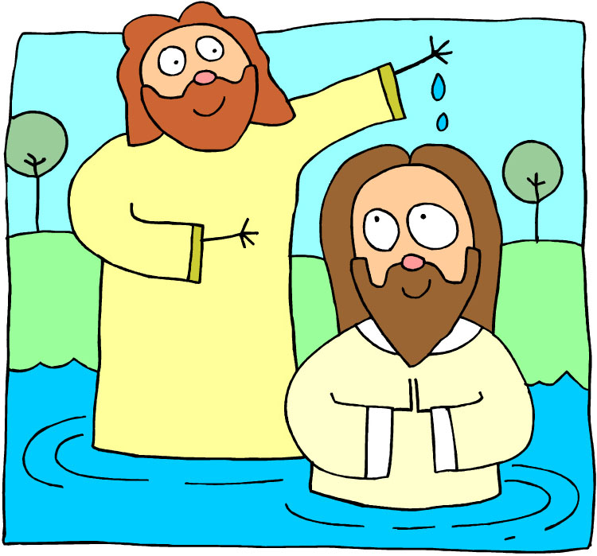
Chapter 21 Vocabulary
βαπτίζω
I baptize

Slide 43
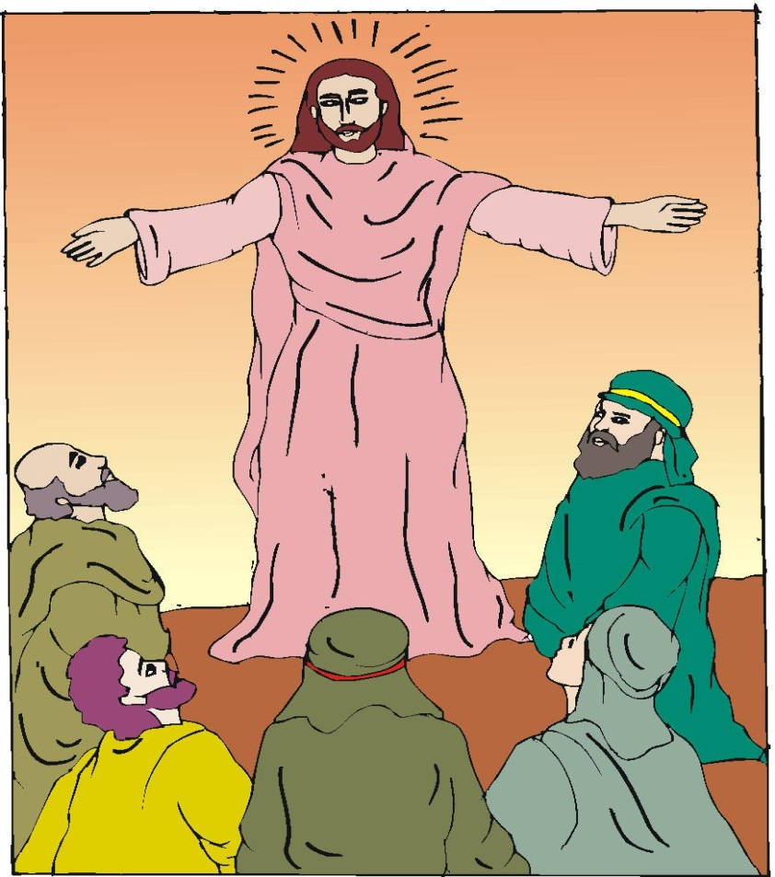
Chapter 21 Vocabulary
εὐαγγέλιον, -ου, τό
gospel

Slide 44
Chapter 21 Vocabulary
μαρτυρέω
I witness

Slide 45
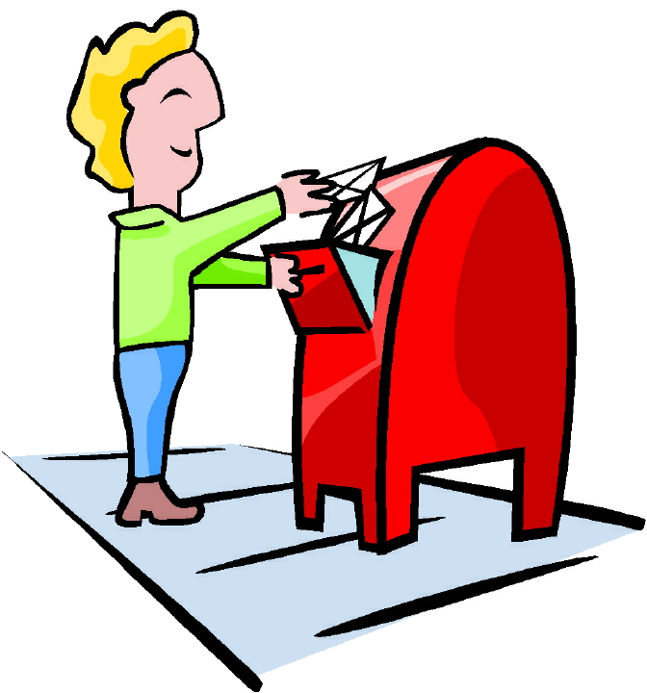
Chapter 21 Vocabulary
πέμπω
I send

Slide 46
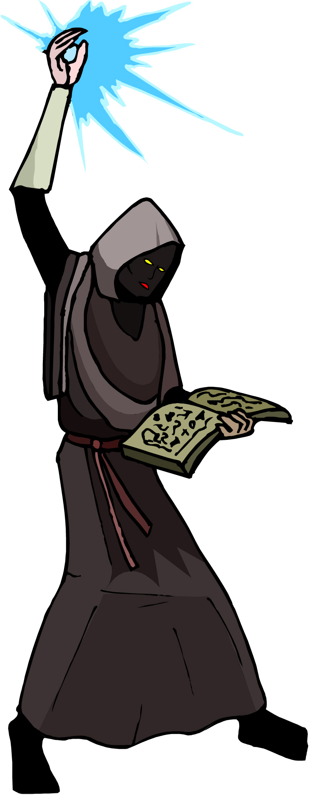
Chapter 21 Vocabulary
προνηρός, -ά, -όν
evil, bad

Slide 47
Chapter 21 Vocabulary
πρόσωπον, -ου, τό
face

Slide 48
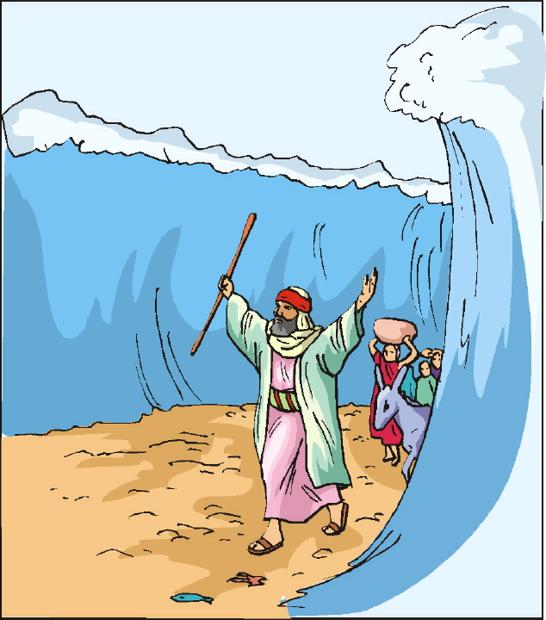
Chapter 21 Vocabulary
σημεῖον, -ου, τό
sign, miracle

Slide 49
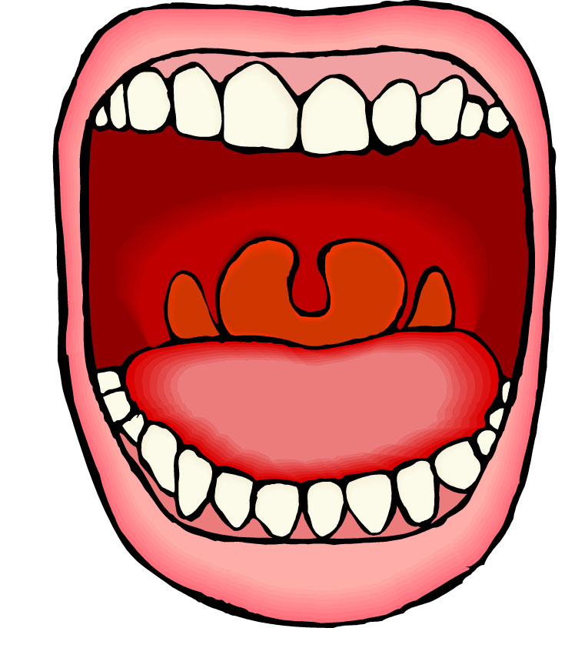
Chapter 21 Vocabulary
στόμα, -ατος, τό
mouth

Slide 50
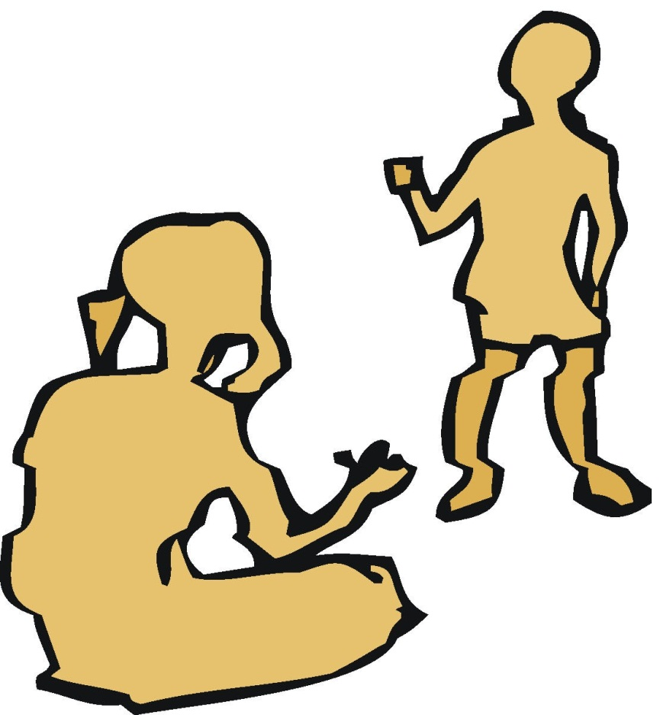
Chapter 21 Vocabulary
ὑπάγω
I go away

Slide 51
Reverse Vocabulary Review

Slide 52
Chapter 20 Vocabulary
ἀναβαίνω
I go up
ἄρχω
I rule, begin (in mid.)
ἕκαστος, -η, -ον
each, every
ἐκβάλλω
I drive out
κἀγώ
and I, but I

Slide 53
Chapter 20 Vocabulary
καταβαίνω
I go down
μᾶλλον
more, rather
μήτηρ, -ός, ἡ
mother
ὅπου
where, since
ὥστε
therefore, so that

Slide 54
Chapter 19 Vocabulary
ἀκολουθέω
I follow
ἐνώπιον
before
θάλασσα, -ης, ἡ
sea, lake
κάθημαι
I sit
καιρός, -οῦ, ὁ
time

Slide 55
Chapter 19 Vocabulary
οὔτε
and not, nor, neither
πίπτω
I fall
πούς, ποδός, ὁ
foot
προσέρχομαι
I come/go to
προσεύχομαι
I pray

Slide 56
Chapter 18 Vocabulary
genna<w
I beget
dikaiosu<nh, -hj, h[
righteousness
e]a<n
if, when
ei]rh<nh, -hj, h[
peace
oi#da
I know

Slide 57
Chapter 18 Vocabulary
oi]ki<a, -aj, h[
house
o[ra<w
I see
peripate<w
I walk
pw?j
how?
fobe<omai
I fear

Slide 58
Chapter 17 Vocabulary
εἰ
if, that
ἐσθίω
I eat
ζάω
I live
ζητέω
I seek
ἤ
or, either

Slide 59
Chapter 17 Vocabulary
καλέω
I call
λαλέω
I speak, say
παρακαλέω
I urge, exhort
πληρόω
I fill, complete
ποιέω
I do, make

Slide 60
Chapter 16 Vocabulary
αἰων, -ῶνος, ὁ
Age, eternity
ἀλλήλων
one another
ἀριερεύς, -έως, ὁ
High priest
γυνή, -αικός, ἡ
woman
δύναμαι
I can, am able

Slide 61
Chapter 16 Vocabulary
ἔθνος, -ους, τό
nation
ὅσος, -η, -ον
as great as
πόλις, -εως, ἡ
city
τέ
And, and so
χείρ, χειρός, ἡ
hand

Slide 62
Chapter 15 Vocabulary
ἄλλος, -η, -ο
other
ἄρτος, -ου, ὁ
bread
δεῖ
it is necessary
ἐξουσία, -ας, ἡ
authority
ἕτερος, -α, -ον
different

Slide 63
Chapter 15 Vocabulary
ἔτι
yet, still
ὀφθαλμός, -οῦ, ὁ
eye
τέκνον, -ου, τό
child
τόπος, -ου, ὁ
place
φῶς, φωτός, τό
light

Slide 64
Chapter 14 Vocabulary
αἷμα, -ματος, τό
blood
αἴρω
I raise, take up
διδάσκω
I teach
ἴδιος, -α, -ον
one's own
καλός, -ή, -όν
good

Slide 65
Chapter 14 Vocabulary
μέλλω
I am about to, intend
ὁδός, -οῦ, ἡ
way
πολύς, πολλή, πολύ
much, many
σῶμα, -ματος, τό
body
ψυχή, -ῆς, ἡ
soul, life

Slide 66
Chapter 13 Vocabulary
ἀνήρ, ἀνδρός, ὁ
man, husband
βασιλεύς, -ἐως, ὁ
king
δύναμις, -εως, ἡ
power, miracle
ὄνομα, -ματος, τό
name
πᾶς, πᾶσα, πᾶν
each, every, all

Slide 67
Chapter 13 Vocabulary
πατήρ, πατρός, ὁ
father
πιστις, πίστεως, ἡ
faith, belief
πνεῦμα, -ατος, τό
spirit, wind
σάρξ, σαρκός, ἡ
flesh, body
χάρις, -ιτος, ἡ
grace, kindness

Slide 68
Chapter 12 Vocabulary
ἀποθνῄσκω
I die
ἐκεῖ
there
ἕως
until
ἰδού
behold

Slide 69
Chapter 12 Vocabulary
ἵνα
in order that, that
Ἰωάννης, -ου, ὁ
John
μέν
on the one hand, indeed
ὅλος, -η, -ον
whole, entire

Slide 70
Chapter 12 Vocabulary
ὅτε
when
σύν
with

Slide 71
Chapter 11 Vocabulary
ἀπέρχομαι
I go away, leave
ἐκεῖνος
that
Ἰουδαῖος, -α, -ον
Jewish
καθώς
as, just as

Slide 72
Chapter 11 Vocabulary
ὅς, ἥ, ὅ
who, which
ὅταν
when
πάλιν
again
οὗτος, αὗτη, τοῦτο
this

Slide 73
Chapter 11 Vocabulary
Πέτρος, -ου, ὁ
Peter
ὑπέρ
for, about (gen.)
above, beyond (acc.)

Slide 74
Chapter 11 Vocabulary
ὑπέρ
for, about (gen.)
above, beyond (acc.)

Slide 75
Vocabulary Ch. 10
life
ζωή, -ῆς, ἡ
death
θάνατος, -ου, ὁ
I judge
κρίνω
I remain
μένω
only, alone
μόνος, -η, -ον

Slide 76
Vocabulary Ch. 10
now
νῦν
and not, nor
οὐδέ
Paul
Παῦλος
I save
σῴζω
then
τότε

Slide 77
Vocabulary Ch. 9
I answer
ἀποκρίνομαι
I send
ἀποστέλλω
I throw
βάλλω
I become
γίνομαι
I come in
εἰσέρχομαι

Slide 78
Vocabulary Ch. 9
I go out
ἐξέρχομαι
I come/go
ἔρχομαι
I wish
θέλω
thus, so
οὕτως
I go
πορεύομαι

Slide 79
Vocabulary Ch. 8
he/she/it
αὐτός, -ή, -ό
land, earth, region
γῆ, -ῆς, ἡ
I, we
ἐγώ, ἡμεῖς
day
ἡμέρα, -ας, ἡ
that, so that
ὅτι

Slide 80
Vocabulary Ch. 8
so, then, therefore
οὖν
crowd
ὄχλος, -ου, ὁ
from
παρά (with Gen.)
beside, with
παρά (with Dat.)
alongside, beside
παρά (with Acc.)

Slide 81
Vocabulary Ch. 8
you / you (pl)
σύ / ὑμεῖς
by, at the hands of
ὑπό (with Gen.)
under, below
ὑπό (with Acc.)

Slide 82
Vocabulary -- Ch. 7
good
ἀγαθός, -ή, -όν
Holy
ἅγιος, -α, -ον
righteous
δίκαιοις, -α, -ον

Slide 83
Vocabulary – Ch. 7
I am
εἰμί
Jewish, a Jew
Ἰουδαῖος, -α, -ον
Great
μέγας, μεγάλη, μέγα

Slide 84
Vocabulary -- Ch. 7
dead
νεκρός, -ά, -όν
no, not
οὐ, οὐκ, οὐχ
first
πρῶτος, -η, -ον
voice
φωνή, -ῆς, ἡ

Slide 85
Chapter 6 Vocabulary
ἀπό (Gen.)
from
διά (Gen.)
through
διά (Acc.)
on account of
εἰς (Acc.)
into

Slide 86
Chapter 6 Vocabulary
ἐκ (Gen.)
out of, from
ἐν (Dat.)
in
ἐπί (Gen.)
on, over
ἐπί (Dat.)
on, at, against, on the basis of

Slide 87
Chapter 6 Vocabulary
ἐπί (Acc.)
on, to, toward, against
κατά (Gen.)
down, against
κατά (Acc.)
according to
μετά (Gen.)
with

Slide 88
Chapter 6 Vocabulary
μετά (Acc.)
after, behind
περί (Gen.)
about, concerning
περί (Acc.)
around, near
πρός (Acc.)
to

Slide 89
Ch. 5 -- Vocabulary
love
ἀγάπη, -ης, ἡ
truth
ἀλήθεια, -ας, ἡ
sin
ἁμαρτία, -ας, ἡ
kingdom
βασιλεία, -ας, ἡ
writing, Scripture
γραφή, -ῆς, ἡ

Slide 90
Ch. 5 -- Vocabulary
I raise up
ἐγείρω
assembly, church
ἐκκλησία, -ας, ἡ
work
ἔργον, -ου, τό
disciple
μαθητής, -οῦ, ὁ
Hour
ὥρα, -ας, ἡ

Slide 91
Ch. 4 -- Vocabulary
I love
ἀγαπάω
I write
γράφω
but, and
δέ
servant, slave
δοῦλος, -ου, ὁ
I find
εὑρίσκω

Slide 92
Ch. 4 -- Vocabulary
temple
ἱερόν, -οῦ, τό
People
λαός, -οῦ, ὁ
law
νόμος, -ου, ὁ
house
οἶκος, -ου, ὁ
as, about, how
ὡς

Slide 93
Ch. 3 -- Vocabulary
but, yet
ἀλλἀ
apostle, sent one
ἀπόστολος, -ου, ὁ
I see
βλέπω
for, then
γάρ
I know
γινώσκω

Slide 94
Ch. 3 -- Vocabulary
Jesus
Ἰησοῦς, -οῦ, ὁ
I take, receive
λαμβάνω
I loose
λύω
heaven
οὐρανός, -οῦ, ὁ
I believe
πιστεύω

Slide 95
Ch. 2 -- Vocabulary
brother
ἀδελφός, -οῦ, ὁ
I hear, obey
ἀκούω
glory, fame
δόξα, -ης, ἡ
I have
ἔχω
world
κόσμος, -ου, ὁ

Slide 96
Ch. 2 -- Vocabulary
Lord, sir
κύριος, -ου, ὁ
word
λόγος, -ου, ὁ
Peter
Πἑτρος, -ου, ὁ
son
υἱός, -οῦ, ὁ
Pharisee
Φαρισαῖος, -ου, ὁ

Slide 97
Ch. 1 -- Vocabulary
angel, messenger
ἄγγελος, -ου, ὁ
verily, truly
ἀμήν
man, humankind
ἄνθρωπος, -ου, ὁ
I
ἐγώ
God
θεός, -οῦ, ὁ

Slide 98
Ch. 1 -- Vocabulary
and, also, even
καί
heart
καρδία, -ας, ἡ
I say
λέγω
prophet
προφήτης, -ου, ὁ
Christ, Messiah
Χριστός, -οῦ, ὁ

Slide 99
In Order Vocabulary Review

Slide 100
Ch. 1 -- Vocabulary
angel, messenger
ἄγγελος, -ου, ὁ
verily, truly
ἀμήν
man, humankind
ἄνθρωπος, -ου, ὁ
I
ἐγώ
God
θεός, -οῦ, ὁ

Slide 101
Ch. 1 -- Vocabulary
and, also, even
καί
heart
καρδία, -ας, ἡ
I say
λέγω
prophet
προφήτης, -ου, ὁ
Christ, Messiah
Χριστός, -οῦ, ὁ

Slide 102
Ch. 2 -- Vocabulary
brother
ἀδελφός, -οῦ, ὁ
I hear, obey
ἀκούω
glory, fame
δόξα, -ης, ἡ
I have
ἔχω
world
κόσμος, -ου, ὁ

Slide 103
Ch. 2 -- Vocabulary
Lord, sir
κύριος, -ου, ὁ
word
λόγος, -ου, ὁ
Peter
Πἑτρος, -ου, ὁ
son
υἱός, -οῦ, ὁ
Pharisee
Φαρισαῖος, -ου, ὁ

Slide 104
Ch. 3 -- Vocabulary
but, yet
ἀλλἀ
apostle, sent one
ἀπόστολος, -ου, ὁ
I see
βλέπω
for, then
γάρ
I know
γινώσκω

Slide 105
Ch. 3 -- Vocabulary
Jesus
Ἰησοῦς, -οῦ, ὁ
I take, receive
λαμβάνω
I loose
λύω
heaven
οὐρανός, -οῦ, ὁ
I believe
πιστεύω

Slide 106
Ch. 4 -- Vocabulary
I love
ἀγαπάω
I write
γράφω
but, and
δέ
servant, slave
δοῦλος, -ου, ὁ
I find
εὑρίσκω

Slide 107
Ch. 4 -- Vocabulary
temple
ἱερόν, -οῦ, τό
People
λαός, -οῦ, ὁ
law
νόμος, -ου, ὁ
house
οἶκος, -ου, ὁ
as, about, how
ὡς

Slide 108
Ch. 5 -- Vocabulary
love
ἀγάπη, -ης, ἡ
truth
ἀλήθεια, -ας, ἡ
sin
ἁμαρτία, -ας, ἡ
kingdom
βασιλεία, -ας, ἡ
writing, Scripture
γραφή, -ῆς, ἡ

Slide 109
Ch. 5 -- Vocabulary
I raise up
ἐγείρω
assembly, church
ἐκκλησία, -ας, ἡ
work
ἔργον, -ου, τό
disciple
μαθητής, -οῦ, ὁ
Hour
ὥρα, -ας, ἡ

Slide 110
Chapter 6 Vocabulary
ἀπό (Gen.)
from
διά (Gen.)
through
διά (Acc.)
on account of
εἰς (Acc.)
into

Slide 111
Chapter 6 Vocabulary
ἐκ (Gen.)
out of, from
ἐν (Dat.)
in
ἐπί (Gen.)
on, over
ἐπί (Dat.)
on, at, against, on the basis of

Slide 112
Chapter 6 Vocabulary
ἐπί (Acc.)
on, to, toward, against
κατά (Gen.)
down, against
κατά (Acc.)
according to
μετά (Gen.)
with

Slide 113
Chapter 6 Vocabulary
μετά (Acc.)
after, behind
περί (Gen.)
about, concerning
περί (Acc.)
around, near
πρός (Acc.)
to

Slide 114
Vocabulary -- Ch. 7
good
ἀγαθός, -ή, -όν
Holy
ἅγιος, -α, -ον
righteous
δίκαιοις, -α, -ον

Slide 115
Vocabulary – Ch. 7
I am
εἰμί
Jewish, a Jew
Ἰουδαῖος, -α, -ον
Great
μέγας, μεγάλη, μέγα

Slide 116
Vocabulary -- Ch. 7
dead
νεκρός, -ά, -όν
no, not
οὐ, οὐκ, οὐχ
first
πρῶτος, -η, -ον
voice
φωνή, -ῆς, ἡ

Slide 117
Vocabulary Ch. 8
he/she/it
αὐτός, -ή, -ό
land, earth, region
γῆ, -ῆς, ἡ
I, we
ἐγώ, ἡμεῖς
day
ἡμέρα, -ας, ἡ
that, so that
ὅτι

Slide 118
Vocabulary Ch. 8
so, then, therefore
οὖν
crowd
ὄχλος, -ου, ὁ
from
παρά (with Gen.)
beside, with
παρά (with Dat.)
alongside, beside
παρά (with Acc.)

Slide 119
Vocabulary Ch. 8
you / you (pl)
σύ / ὑμεῖς
by, at the hands of
ὑπό (with Gen.)
under, below
ὑπό (with Acc.)

Slide 120
Vocabulary Ch. 9
I answer
ἀποκρίνομαι
I send
ἀποστέλλω
I throw
βάλλω
I become
γίνομαι
I come in
εἰσέρχομαι

Slide 121
Vocabulary Ch. 9
I go out
ἐξέρχομαι
I come/go
ἔρχομαι
I wish
θέλω
thus, so
οὕτως
I go
πορεύομαι

Slide 122
Vocabulary Ch. 10
life
ζωή, -ῆς, ἡ
death
θάνατος, -ου, ὁ
I judge
κρίνω
I remain
μένω
only, alone
μόνος, -η, -ον

Slide 123
Vocabulary Ch. 10
now
νῦν
and not, nor
οὐδέ
Paul
Παῦλος
I save
σῴζω
then
τότε

Slide 124
Chapter 11 Vocabulary
ἀπέρχομαι
I go away, leave
ἐκεῖνος
that
Ἰουδαῖος, -α, -ον
Jewish
καθώς
as, just as

Slide 125
Chapter 11 Vocabulary
ὅς, ἥ, ὅ
who, which
ὅταν
when
πάλιν
again
οὗτος, αὗτη, τοῦτο
this

Slide 126
Chapter 11 Vocabulary
Πέτρος, -ου, ὁ
Peter
ὑπέρ
for, about (gen.)
above, beyond (acc.)

Slide 127
Chapter 11 Vocabulary
ὑπέρ
for, about (gen.)
above, beyond (acc.)

Slide 128
Chapter 12 Vocabulary
ἀποθνῄσκω
I die
ἐκεῖ
there
ἕως
until
ἰδού
behold

Slide 129
Chapter 12 Vocabulary
ἵνα
in order that, that
Ἰωάννης, -ου, ὁ
John
μέν
on the one hand, indeed
ὅλος, -η, -ον
whole, entire

Slide 130
Chapter 12 Vocabulary
ὅτε
when
σύν
with

Slide 131
Chapter 13 Vocabulary
ἀνήρ, ἀνδρός, ὁ
man, husband
βασιλεύς, -ἐως, ὁ
king
δύναμις, -εως, ἡ
power, miracle
ὄνομα, -ματος, τό
name
πᾶς, πᾶσα, πᾶν
each, every, all

Slide 132
Chapter 13 Vocabulary
πατήρ, πατρός, ὁ
father
πιστις, πίστεως, ἡ
faith, belief
πνεῦμα, -ατος, τό
spirit, wind
σάρξ, σαρκός, ἡ
flesh, body
χάρις, -ιτος, ἡ
grace, kindness

Slide 133
Chapter 14 Vocabulary
αἷμα, -ματος, τό
blood
αἴρω
I raise, take up
διδάσκω
I teach
ἴδιος, -α, -ον
one's own
καλός, -ή, -όν
good

Slide 134
Chapter 14 Vocabulary
μέλλω
I am about to, intend
ὁδός, -οῦ, ἡ
way
πολύς, πολλή, πολύ
much, many
σῶμα, -ματος, τό
body
ψυχή, -ῆς, ἡ
soul, life

Slide 135
Chapter 15 Vocabulary
ἄλλος, -η, -ο
other
ἄρτος, -ου, ὁ
bread
δεῖ
it is necessary
ἐξουσία, -ας, ἡ
authority
ἕτερος, -α, -ον
different

Slide 136
Chapter 15 Vocabulary
ἔτι
yet, still
ὀφθαλμός, -οῦ, ὁ
eye
τέκνον, -ου, τό
child
τόπος, -ου, ὁ
place
φῶς, φωτός, τό
light

Slide 137
Chapter 16 Vocabulary
αἰων, -ῶνος, ὁ
Age, eternity
ἀλλήλων
one another
ἀρχιερεύς, -έως, ὁ
High priest
γυνή, -αικός, ἡ
woman
δύναμαι
I can, am able

Slide 138
Chapter 16 Vocabulary
ἔθνος, -ους, τό
nation
ὅσος, -η, -ον
as great as
πόλις, -εως, ἡ
city
τέ
And, and so
χείρ, χειρός, ἡ
hand

Slide 139
Chapter 17 Vocabulary
εἰ
if, that
ἐσθίω
I eat
ζάω
I live
ζητέω
I seek
ἤ
or, either

Slide 140
Chapter 17 Vocabulary
καλέω
I call
λαλέω
I speak, say
παρακαλέω
I urge, exhort
πληρόω
I fill, complete
ποιέω
I do, make

Slide 141
Chapter 18 Vocabulary
genna<w
I beget
dikaiosu<nh, -hj, h[
righteousness
e]a<n
if, when
ei]rh<nh, -hj, h[
peace
oi#da
I know

Slide 142
Chapter 18 Vocabulary
oi]ki<a, -aj, h[
house
o[ra<w
I see
peripate<w
I walk
pw?j
how?
fobe<omai
I fear

Slide 143
Chapter 19 Vocabulary
ἀκολουθέω
I follow
ἐνώπιον
before
θάλασσα, -ης, ἡ
sea, lake
κάθημαι
I sit
καιρός, -οῦ, ὁ
time

Slide 144
Chapter 19 Vocabulary
οὔτε
and not, nor, neither
πίπτω
I fall
πούς, ποδός, ὁ
foot
προσέρχομαι
I come/go to
προσεύχομαι
I pray

